Slide 1


SAML (Security Assertion Markup Language)
February 2017

Slide 2
Version Sheet: MANDATORY (hidden in ‘slide show’ mode)
Version | Changes | Author
001 | Redesign | Nachiket Rajadhyaksha

Slide 3
Ground Rules for Onsite Classrooms
Everyone participates
Respect individual opinions and diversities
Be open and honest
Give headlines, be concise
One speaker at a time
Make language a non-issue
Stick to time contracts
Seek first to understand, and then to be understood
Clean desk / room policy
No mobile phone, no computer
Clients & Leadership are often here, please remember that
Maintain a spirit of fun and enthusiasm

Slide 4
Objectives
Note to SME:
Please enter the Business Objectives/Purpose
Business Objectives/Purpose
To <enter what the business wants to achieve through this module>
Learning Objectives/Products
At the end of this module/course, we will be able to:
Explain What are the security requirements.
Explain why Auth2 over Http basic authentication, network security, certificate based security, custom authentication token.
Describe Auth2 key features.
Explain the role of client application, resource server, authorization server.
Explain the Abstract protocol flow
Explain why token type.
Explain Bearer token type
Describe an Example Application with Configuration
Explain SAML and its basic concepts
Explain SAML Web Sso Profiles : IdP initiated and SP initiated
Explain SAML Vs OAuth

Slide 5
Module at a glance
Note to SME:
Need SME input for this screen.
Target Audience: | Designation (s), Roles (s)
Course Level: | <Beginner/Intermediate/Advanced>
Duration (in hours):
Pre-requisites, if any: | <None>
Post-requisites, if any: | <None>
Relevant Certifications: | <None>

Slide 6
Agenda
 | What are the security requirements?
 | Why Auth2 over Http basic authentication, network security, certificate based security, custom authentication token.
 | Auth2 key features and Introduction.
 | Role of client application, resource server, authorization server and Real world example
 | Abstract protocol flow
 | Authorization grant types
 | Why token type?
 | Bearer token type
 | Example Application with configuration
 | SAML and its basic concepts
 | SAML Web Sso Profiles : IdP initiated and SP initiated
 | SAML Vs OAuth

Slide 7
Prerequisites & Success Criteria
Prerequisites
Success Criteria
Familiarity with security basics
Familiarity with JSON and XML
Familiarity with SSO concepts
Familiarity with Identity management fundamentals
Enable to oAuth 2.0 and SAML approaches for implementation.
Security

Slide 8

What are the Security Requirements?
Identity and permissions:
How is identity and permission information conveyed to a service?
How is it decoded and interpreted?
What data are needed to make the access decision (user accounts, roles, ACLs etc.)?
How is the data managed: who is responsible for storing and retrieving it?
How can you verify that the request hasn't been tampered with?
Stop bad guys from accessing your resources

Slide 9
HTTP Basic Authentication
Description
Something of a lowest common denominator.
Supported on practically all servers natively and out of the box.
Ubiquitous support on the client side in all languages.
Good support in Spring Security
Spring Boot autoconfigures it out of the box
What’s wrong with it?
Where do you get the credentials (the username and password)?
Fine for systems where all participants can share secrets securely
In practice that means small systems Only supports username/password
Only covers authentication
No distinction between users and machines

Slide 10
Network Security
Description
Microservice endpoints not visible outside an internal network
Very secure
Very flexible (e.g. using virtual networks)
Suits architecture based on "edge" server
What’s wrong with it?
Annoying to debug and a little bit fiddly to maintain
Configuration is out of the control of developers in many cases for organizational reasons.
There's no identity or authentication

Slide 11
Certificate Based Security
Description
Set up SSL on server so that request has to contain certificate
Spring Security (X.509) can turn that into an Authentication
If SSL is in the service layer (i.e. not at the router/loadbalancer) then you have a keystore anyway
What’s wrong with it?
There's no user identity (only at most the machine) unless browsers have certificates installed
Requires keystores and certificates in all applications and services (significantly non-trivial if done properly, but some organizations require it anyway)
No fine distinction between users and machines

Slide 12
Custom Authentication Token
Description
Random identifier per authentication
Grant them from a central service and/or store in a central database
Can be exposed directly via developer UI
Spring Security AbstractPreAuthenticatedProcessingFilter and friends
Even easier: Spring Session identifier
Github example: token is temporary password in HTTP Basic
What’s wrong with it?
No separation of client app from user authentication
Coarse grained authorization (all tokens activate all resources)
It's not a "standard" (but there are ready made implementations)
For user authentication, need to collect user credentials in app

Slide 13
OAuth2 Key Features
Extremely simple for clients.
Access tokens carry information (beyond identity)
Resources are free to interpret token content

Slide 14
Quick Introduction to OAuth2
A Client application, often web application, acts on behalf of a User, but with the User's approval.
OAuth stands for “Open Authorization”.
Allows providers to give access to users without any exchange of credentials. Designed for use only with HTTP protocol. It doesnot support any other protocol.
An open standard protocol that provides simple and secure authorization for different type of applications.
A simple and safe mode for consumers to interact with protected data.

Slide 15
OAuth2 Roles
Resource Owner
Resource Server
Client Application
Authorization Server
User
API
3rd party application
Auth API (may be in scope of Resource Server)

Slide 16
OAuth2 Roles
Common examples of Authorization Servers and Resource Servers on the internet:
Facebook: Graph API
Google: Google API
Cloud Foundry: Cloud Controller

Slide 17
Role of Client Application
Register with Authorization Server (get a client_id and maybe a client_secret)
Do not collect user credentials
Obtain a token (opaque) from Authorization Server on its own behalf - client_credentials, On behalf of a user
Use it to access Resource Server.

Slide 18
Role of Resource Server
Extract token from request and decode it.
. Make access control decision
◦ Scope
◦ Audience
◦ User account information (id, roles etc.)
◦ Client information (id, roles etc.)
Send 403 (FORBIDDEN) if token not sufficient

Slide 19
Role of the Authorization Server
Compute token content and grant tokens
Interface for users to confirm that they authorize the Client to act on their behalf
Authenticate users (/authorize)
Authenticate clients (/token)

Slide 20
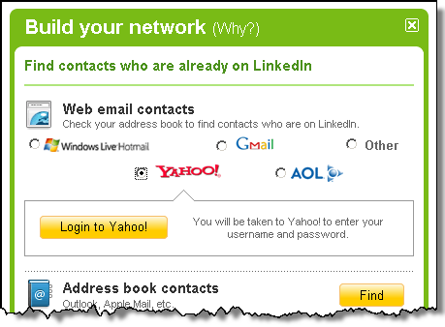
Example: User navigates to Resource Client

Slide 21
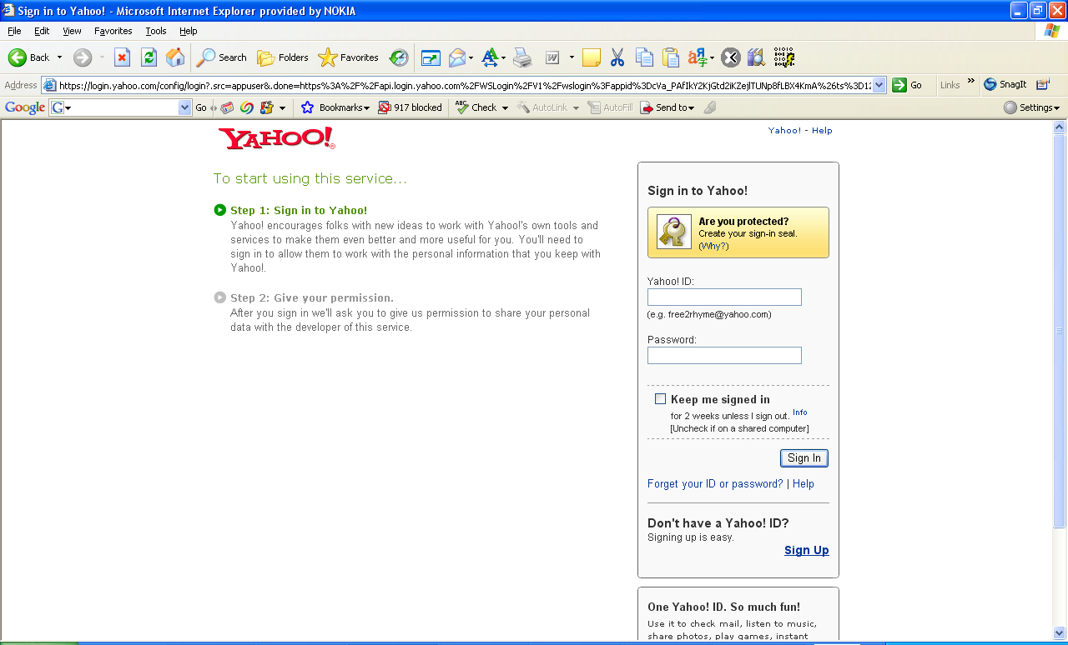
Example: User authenticated by Authorization Server

Slide 22
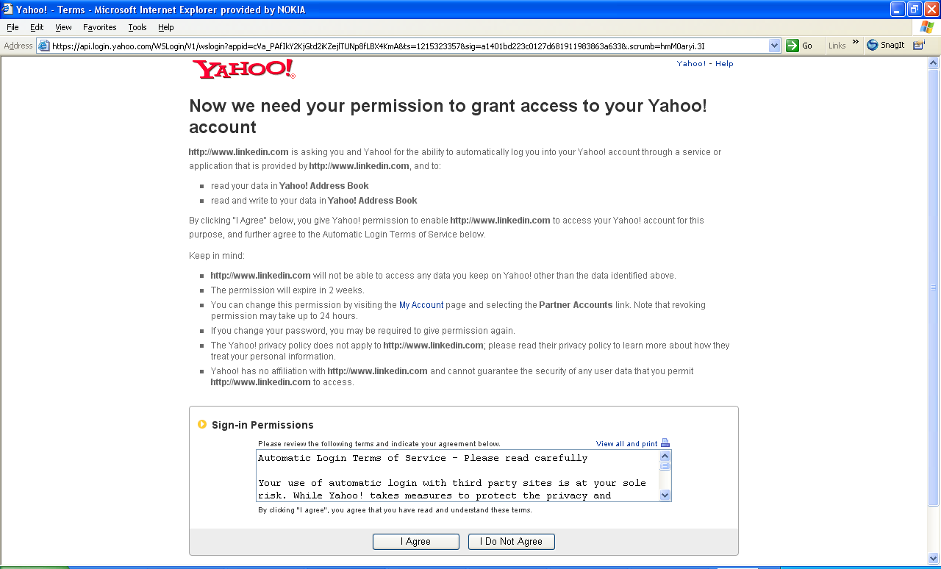
Example: User authenticated by Authorization Server

Slide 23
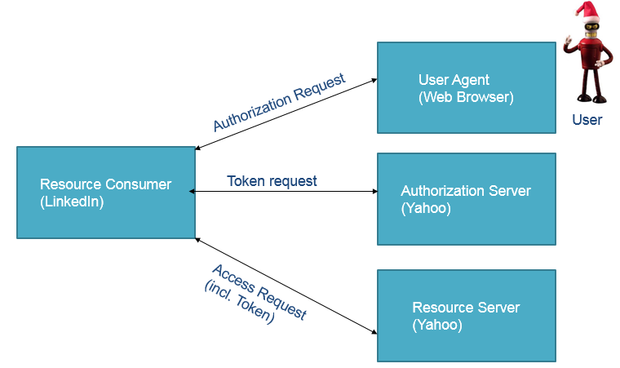
Entities

Slide 24
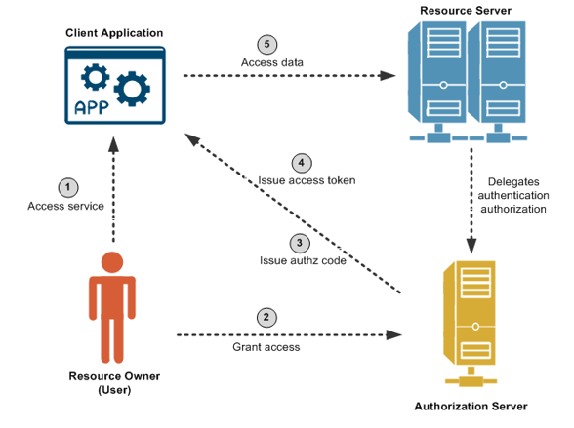
OAuth2 Workflow

Slide 25
Detailed Explanation
Consider a problem:
Resource Server:
Assume that you are using a image printing website such as Canon to print some of your photos. You also have some photos on your Flickr account that you would like to print. However, you must download all these locally, and then upload them again to the printing website, which is inconvenient. You would like to be able to sign into Flickr from your Canon printing profile, and print your photos directly.
The Canon printing client application pre-registers with Flickr and obtains a client ID/secret. The client application registers a callback URL to receive the authorization code from Flickr when you, as Resource Owner, allow Canon to access the photos from Flickr. The printing application has also requested access to an API named /flickr/photos, which has an OAuth scope of photos.

Slide 26
Detailed Explanation
The steps in the diagram are described as follows:
You are using a mobile phone and are signed into the Canon image printing website. You click to print Flickr photos. The Canon client app redirects you to the Flickr OAuth Authorization Server. You must already have a Flickr account.
You log into your Flickr account, and the Flickr Authorization Server asks you "Do you want to allow the Canon printing app to access your photos?". You click Yes to authorize.
When successful, the printing app receives an authorization code at the callback URL that was pre-registered out of band.
The client app gets the authorization code, and must exchange this short-lived code for an access token. The client app sends another request to the Authorization Server, saying it has a code that proves the user has authorized it to access their photos, and now issue the access token to be sent on to the API (Resource Server). The Authorization Server verifies the authorization code and returns an access token.
The client app sends the access token to the API (Resource Server), and receives the photos as requested.

Slide 27
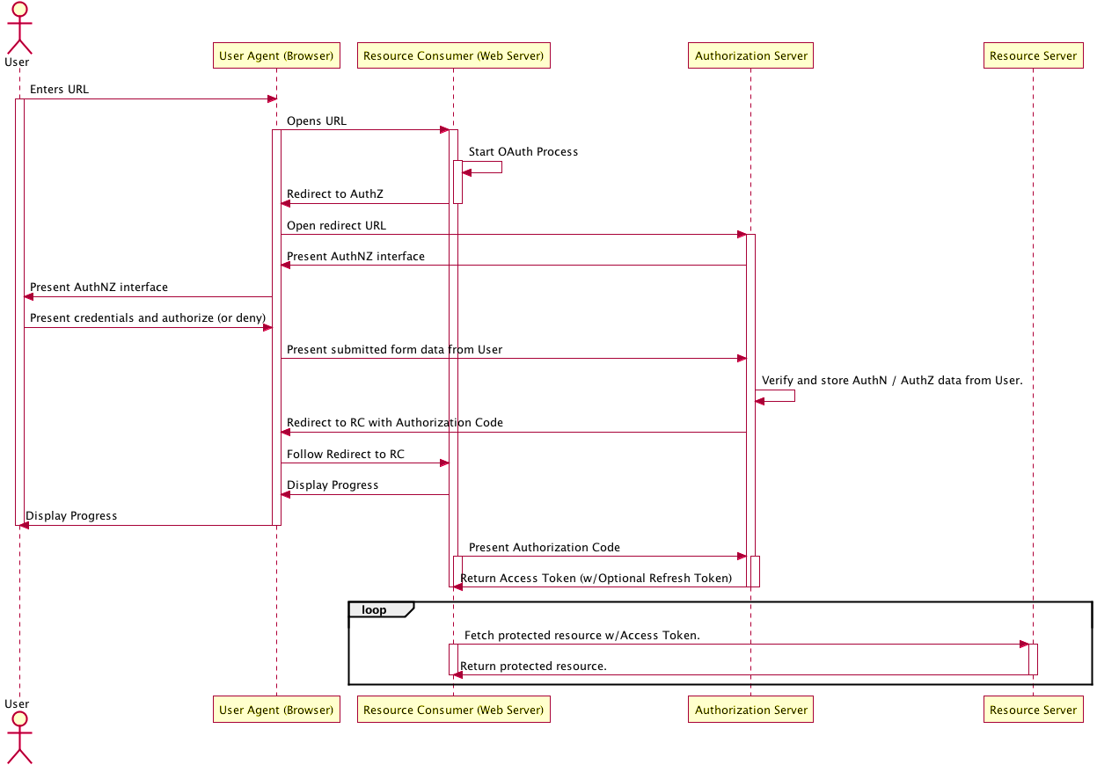
Authorization Code Flow

Slide 28
OAuth 2.0 Grant
OAuth 2 defines four grant types, each of which is useful in different cases:
1. Authorization code grant flow
-Web-server apps: authorization_code
2. Implicit grant flow
-Browser-based apps: implicit
-Mobile apps – implicit
3. Resource owner password credentials grant flow
-Username/password access: password
4. Client credentials grant flow
-Application access: client credentials

Slide 29
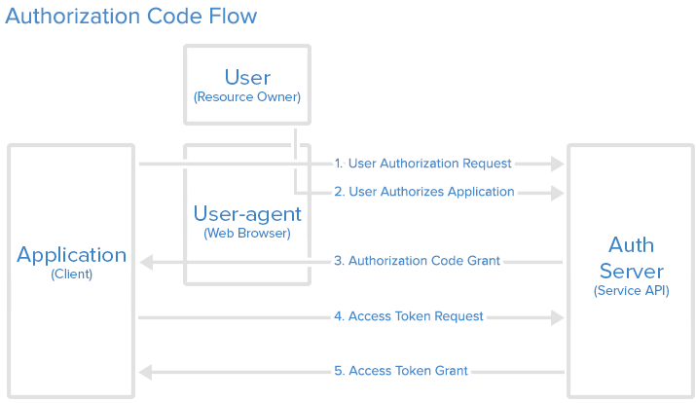
Detailed Workflow Description Diagram

Slide 30
Authorization code grant flow
User visits the authorization page https://facebook.com/dialog/oauth?response_type=code&client_id=28 653682475872&redirect_uri=everydaycity.com&scope=email
On success, user is redirected back to your site with auth code https://example.com/auth?code=AUTH_CODE_HERE
On error, user is redirected back to your site with error code https://example.com/auth?error=access_denied
Server exchanges auth code for an access token POST https://graph.facebook.com/oauth/access_token
Post Body: grant_type=authorization_code &code=CODE_FROM_QUERY_STRING &redirect_uri=REDIRECT_URI &client_id=YOUR_CLIENT_ID &client_secret=YOUR_CLIENT_SECRET

Slide 31
Authorization code grant flow
Your server gets a response like the following {
"access_token":"RsT5OjbzRn430zqMLgV3Ia", "token_type":"bearer",
"expires_in":3600,
"refresh_token":"e1qoXg7Ik2RRua48lXIV"
}
or if there was an error
{
"error":"invalid_request"
}

Slide 32
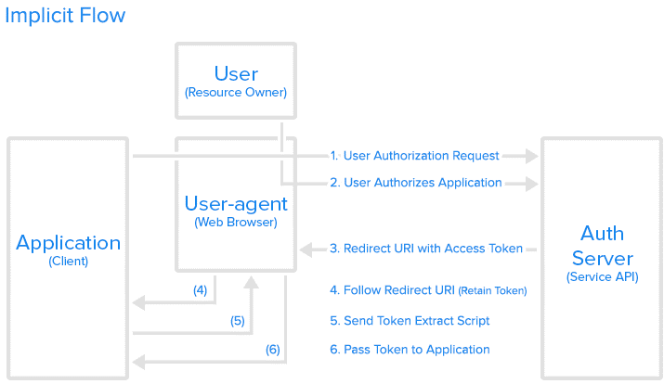
Implicit Grant Flow

Slide 33
Implicit grant flow
User visits the authorization page https://facebook.com/dialog/oauth?response_type=token&client_id=2 865368247587&redirect_uri=everydaycity.com&scope=email
On success, user is redirected back to your site with the access token in the fragment https://example.com/auth#token=ACCESS_TOKEN
On error, user is redirected back to your site with error code
https://example.com/auth#error=access_denied

Slide 34
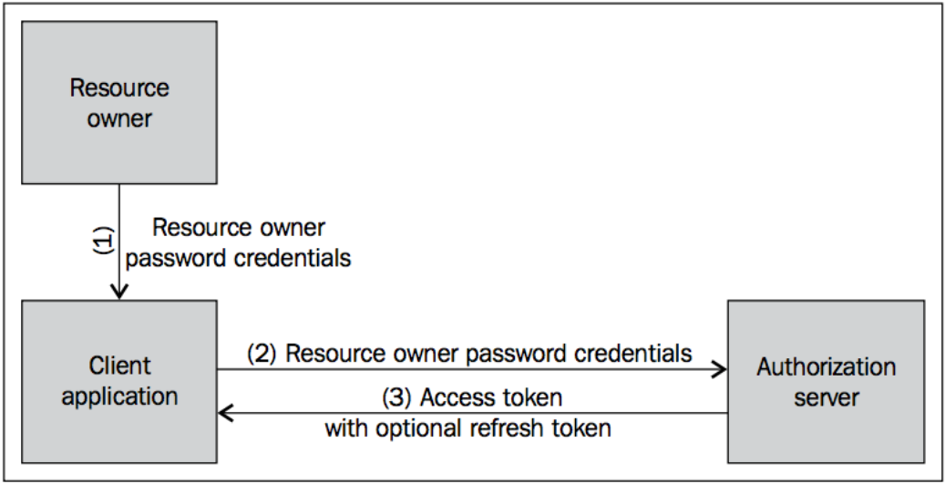
Resource Owner password credentials flow

Slide 35
Resource Owner password credentials flow
POST:
https://api.example.com/oauth/token
Post Body:
grant_type=password
&username=USERNAME
&password=PASSWORD
&client_id=YOUR_CLIENT_ID
&client_secret=YOUR_CLIENT_SECRET
Response:
{
"access_token":"RsT5OjbzRn430zqMLgV3Ia", "token_type":"bearer", "expires_in":3600, "refresh_token":"e1qoXg7Ik2RRua48lXIV"
}

Slide 36
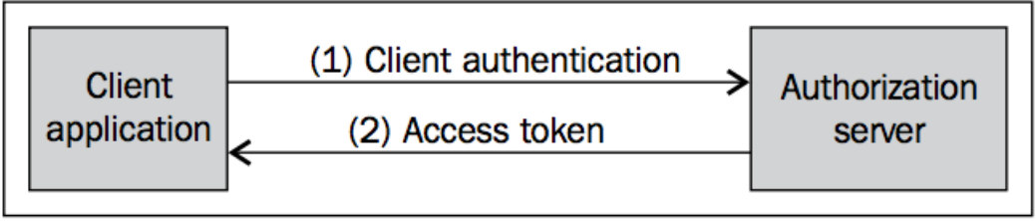
Client Credentials Grant Flow

Slide 37
Client Credentials Grant Flow
POST
https://api.example.com/1/oauth/token
Post Body:
grant_type=client_credentials
&client_id=YOUR_CLIENT_ID &client_secret=YOUR_CLIENT_SECRET
Response:
{
"access_token":"RsT5OjbzRn430zqMLgV3Ia", "token_type":"bearer", "expires_in":3600, "refresh_token":"e1qoXg7Ik2RRua48lXIV"
}

Slide 38
Why token type?
OAuth 2.0 core specification does not mandate any token type. At the same time at any point token requester (client) cannot decide which token type it needs. It's purely up to the Authorization Server to decide which token type to be returned in the Access Token response. So, the token type comes in to action in phase-2 when Authorization Server returning back the OAuth 2.0 Access Token.
The access token type provides the client with the information required to successfully utilize the access token to make a protected resource request (along with type-specific attributes).
Each access token type definition specifies the additional attributes (if any) sent to the client together with the "access token" response parameter. It also defines the HTTP authentication method used to include the access token when making a protected resource request.

Slide 39
OAuth 2.0 Bearer Token type
Centralizing account management and permissions:
OAuth 2.0 adds an extra dimension - more information for the access decision
Standards always help in security
Lightweight - easy to curl
Requires HTTPS for secure operation, but you can test with HTTP
Bearer can be simply understood as "give access to who ever brings the bearer token." One valid token and no question asked. On the other hand if you choose Mac and sign_type(default hmac-sha-1 on most implementation), the access token is generated and kept as secret in Key Manager as a attribute, and an encrypted secret is sent back as access_token.

Slide 40
Example Application: Brief
We create a minimal application that uses Facebook for authentication using auto-configuration features in Spring Boot.
When you visit the home page at http://localhost:8080. Instead of the home page you should be redirected to login with Facebook. If you do that, and accept any authorizations you are asked to make, you will be redirected back to the local app and the home page will be visible.
If you stay logged into Facebook, you won’t have to re-authenticate with this local app, even if you open it in a fresh browser with no cookies and no cached data. (That’s what Single Sign On means.)

Slide 41
pom.xml
<dependency>
<groupId>org.springframework.boot</groupId>
<artifactId>spring-boot-starter-security</artifactId>
</dependency>
<dependency>
<groupId>org.springframework.security.oauth</groupId>
<artifactId>spring-security-oauth2</artifactId>
</dependency>
<dependency>
<groupId>org.webjars</groupId>
<artifactId>angularjs</artifactId>
<version>1.4.3</version>
</dependency>
<dependency>
<groupId>org.webjars</groupId>
<artifactId>jquery</artifactId>
<version>2.1.1</version>
</dependency>
To make the application secure : add Spring Security dependency. If we do that the default will be to secure it with HTTP Basic.
Since we want to do a "social" login (delegate to Facebook), we add the Spring Security OAuth2 dependency as well.

Slide 42
Application class
@SpringBootApplication
@EnableOAuth2Sso
public class SimpleApplication {
public static void main(String[] args) {
SpringApplication.run(SimpleApplication.class, args);
}
}
To make link to Facebook we need an @EnableOAuth2Sso annotation on our main class.

Slide 43
…and some configuration (converting application.properties to YAML for better readability):
security:
oauth2:
client:
clientId: 233668646673605
clientSecret: 33b17e044ee6a4fa383f46ec6e28ea1d
accessTokenUri: https://graph.facebook.com/oauth/access_token
userAuthorizationUri: https://www.facebook.com/dialog/oauth
tokenName: oauth_token
authenticationScheme: query
clientAuthenticationScheme: form
resource:
userInfoUri: https://graph.facebook.com/me
The configuration refers to a client app registered with Facebook in their developers site, in which you have to supply a registered redirect (home page) for the app. This one is registered to "localhost:8080" so it only works in an app running on that address.

Slide 44
Index.html (AngularJS)
<!doctype html>
<html lang="en">
<head>
<meta charset="utf-8"/>
<meta http-equiv="X-UA-Compatible" content="IE=edge"/>
<title>Demo</title>
<meta name="description" content=""/>
<meta name="viewport" content="width=device-width"/>
<base href="/"/>
<link rel="stylesheet" type="text/css" href="/webjars/bootstrap/css/bootstrap.min.css"/> <script type="text/javascript" src="/webjars/jquery/jquery.min.js"></script>
<script type="text/javascript" src="/webjars/bootstrap/js/bootstrap.min.js"></script>
</head>
<body>
<h1>Demo</h1>
<div class="container"></div>
</body>
</html>

Slide 45
Summary of the example application
The app is a Client Application and it uses the authorization code grant to obtain an access token from Facebook (the Authorization Server).
It then uses the access token to ask Facebook for some personal details (only what you permitted it to do), including your login ID and your name. In this phase facebook is acting as a Resource Server, decoding the token that you send and checking it gives the app permission to access the user’s details.
If that process is successful the app inserts the user details into the Spring Security context so that you are authenticated.

Slide 47
What is SAML?
-Security Assertion Markup Language
-XML based protocol
Flexible and extensible protocol designed to be used by other standards
OASIS approved standard
-SAML 1.0 November 2002
-SAML 1.1 September 2003
-SAML 2.0 March 2005
Advantages of SAML:
-Platform neutral
-Loose coupling of directories
-Improved online experience for end users
-Supported by many SAAS Applications
-Strong commercial and open source support

Slide 48
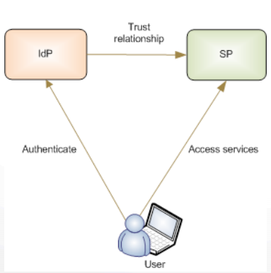
SAML Roles
Identity Provider (IdP)/ Asserting party
Service Provider (SP) / Relying party
User
An asserting party is a system entity that makes SAML assertions.
A relying party is a system entity that uses assertions it has received.
A relying party's willingness to rely on information from an asserting party depends on the existence of a trust relationship with the asserting party.

Slide 49
SAML basic concepts
3 Main Protocols—Assertions:
a. Authentication statements
b. Attribute statements
c. Authorization decision statements
Protocol—the way SAML asks for and gets assertions, for example, using SOAP over HTTP.
Bindings—how SAML message exchanges are mapped into SOAP exchanges
Profile—defines constraints on the contents of SAML assertions, protocols, and bindings in order to solve the business use case in an interoperable fashion

Slide 50
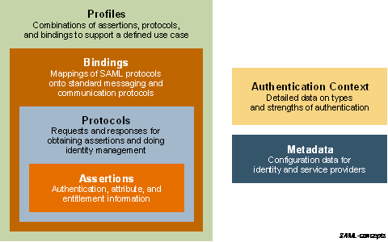
SAML basic concepts

Slide 51
Web Browser SSO Profile: Message flows (Based on where user starts the process of a web SSO exchange)
SP initiated :
Begins with the user clicking a link that takes them directly to an SP application resource they need to access. since the user is not logged in at the SP, before it allows access to the resource, the SP sends the user to an IdP to authenticate.
The IdP builds an assertion representing the user's authentication at the IdP and then sends the user back to the SP with the assertion. The SP processes the assertion and determines whether to grant the user access to the resource.
IdP initiated:
The user is visiting an IdP where they are already authenticated and they click on a link to a partner SP.
The IdP builds an assertion representing the user's authentication state at the IdP and sends the user's browser over to the SP's assertion consumer service, which processes the assertion and creates a local security context for the user at the SP.
This approach is useful in certain environments, but requires the IdP to be configured with inter-site transfer links to the SP's site

Slide 52
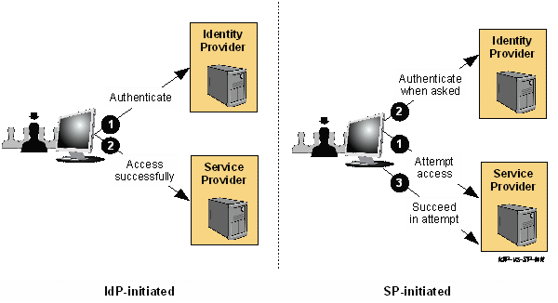
SP-initiated Vs IdP-initiated

Slide 53
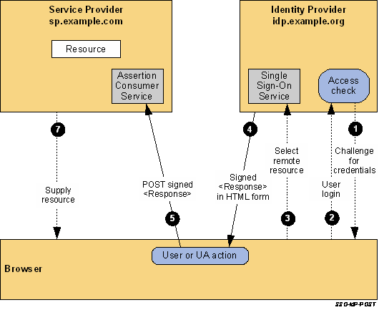
IdP-Initiated SSO: POST Binding Flow

Slide 54
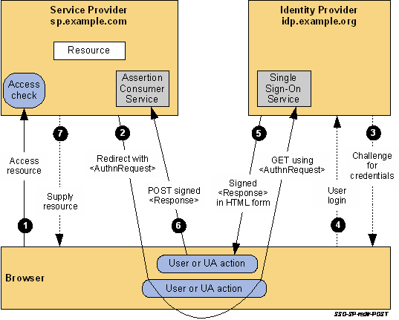
SP-Initiated SSO: POST Bindings Flow

Slide 55
SP-Initiated SSO: POST Bindings Flow
 | OAuth2 | SAML
Definition | (Open Authorization) is a standard for authorization of resources. It does not deal with authentication. | Security Assertion Markup Language) is an umbrella standard that encompasses profiles, bindings and constructs to achieve Single Sign On (SSO), Federation and Identity Management.
Token/Message Format | OAuth tokens can be binary, JSON or SAML | SAML deals with XML as the data construct or token format.
Transport | OAuth uses HTTP exclusively | SAML has Bindings that use HTTP such as HTTP POST Binding, HTTP REDIRECT Binding etc. But there is no restriction on the transport format. You can use SOAP or JMS or any transport
Scope | OAuth is designed for applications on the internet, primarily for delegated authorization of internet resources. | SAML is used in Enterprise SSO scenarios. - within an enterprise or - enterprise to partner or - enterprise to cloud scenarios.
When should I use which? | If your usecase involves providing access (temporarily or permanent) to resources (such as accounts, pictures, files etc), then use OAuth. If your usecase involves mobile devices, then OAuth2 with some form of Bearer Tokens is appropriate. | If your use-case involves SSO (when at least one actor or participant is an enterprise). If you need to provide access to a partner or customer application to your portal. If your use-case requires a centralized identity source, then use SAML (Identity provider).

Slide 56
References:
https://spring.io/guides/tutorials/spring-boot-oauth2/
http://docs.oasis-open.org/security/saml/Post2.0/sstc-saml-tech-overview-2.0.html
https://dzone.com/articles/saml-versus-oauth-which-one

